Slide 1
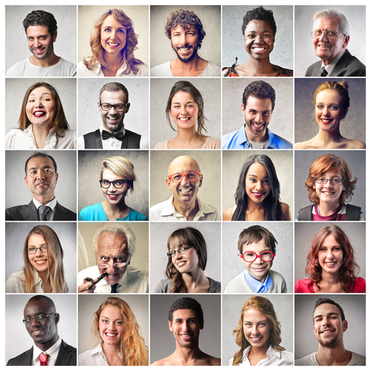
Personas and Scenarios CSCI 5839 Fall 2014 Shaun Kane
Notes:
http://searchengineland.com/figz/wp-content/seloads/2014/01/personas.jpg

Slide 2
Today
Analyzing data (briefly)
Personas and scenarios – tools for using data in design

Slide 3
Zooming out
This week
Personas & scenarios
Brainstorming on input and output
Next week
Sketching, project reports
Week after
Storyboarding and paper prototyping

Slide 4
Zooming out
This week
Personas & scenarios
Brainstorming on input and output
Next week
Sketching, project reports
Week after
Storyboarding and paper prototyping
Hands on design work

Slide 5
What to do with our data?
By now we have collected lots of data about users, their environment, and their activities
How do we turn this into usable knowledge for design?

Slide 6
What to do with data
Finding themes in data
Representing users
Representing tasks and environments
Affinity diagramming
Personas
Scenarios

Slide 7
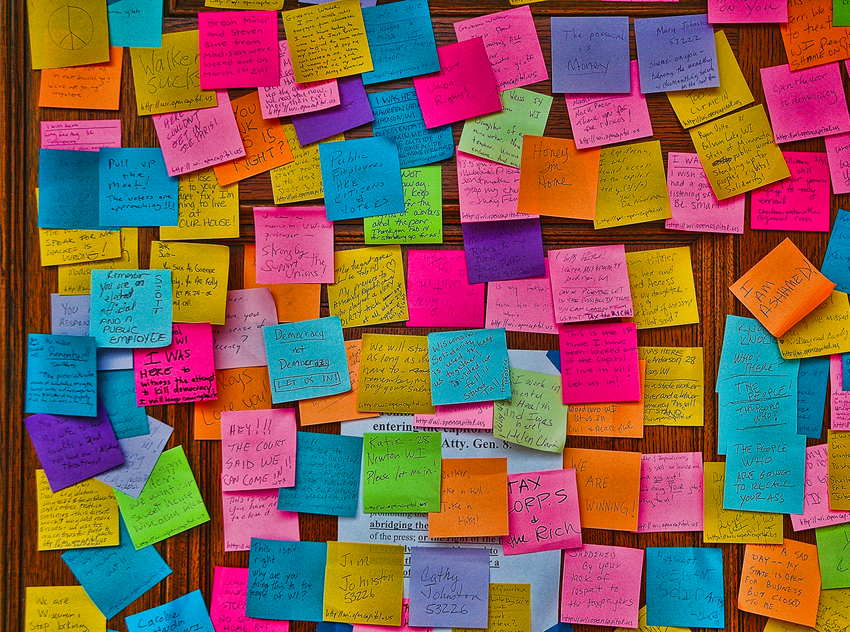
Identifying themes
You’ll inevitably end up with a bunch of data about different kinds of things
How to identify trends or themes?
Notes:
http://amormagazine.co.uk/wp-content/uploads/2014/09/post.jpg

Slide 8
Affinity diagramming
Enumerate all of the ideas that you have; write each on a Post-It
Put post-its on the wall
Arrange into logical groups
Label the groups
Similar to card sorting

Slide 9
Let’s try it
5 minutes: generate as many ideas as you can about challenges in your problem area–why is solving this problem difficult?
(draw on real data if you have it)
5 minutes: arrange in groups. What are the themes?

Slide 10
Personas
Often we can collect a LOT of data about our potential users
Often we have many users to consider
Facebook has approximately 1 billion users

Slide 11
Personas
Identify trends and similarities in your data
Personas: Fictional individual who conveys several of the trends you found in the data
Capture and present these personas in a way that captures
Notes:
Go to Neha’s questions

Slide 12

Personas
Identify trends and similarities in your data
Fictional individuals that represent user characteristics from your data
Based on data, but you may combine or mix up attributes
Beatrice
39 years old
Lives in Boulder
Owns an apple farm
Is worried that her dog is not keeping up w/ neighbors’
Notes:
Go to Neha’s questions

Slide 13
What goes into a persona?
Give them a name and a photo
Much easier to say “Philippe” than “teenage smartphone users in Indonesia”
Photos humanize them
Few other standard components
Demographic data can be useful
But what do you really need to know?
Make them interesting
You’ll spend a lot of time with them
Represent typical users and interesting outliers

Slide 14
Example Personas
Older adult personas for designing technology in the home, by Francine Gemperle
Web user personas from “A Web for Everyone” by Sarah Horton and Whitney Quesenbery

Slide 15
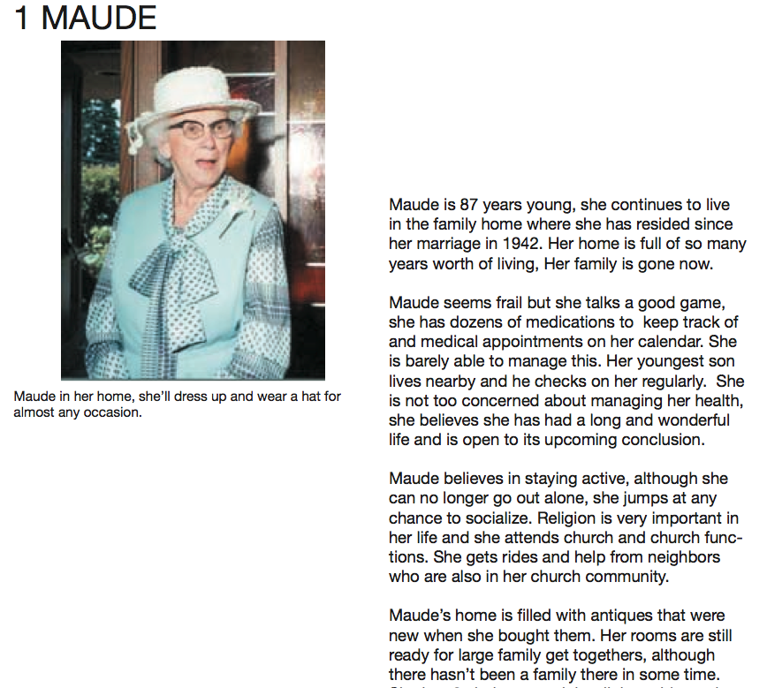

Slide 16
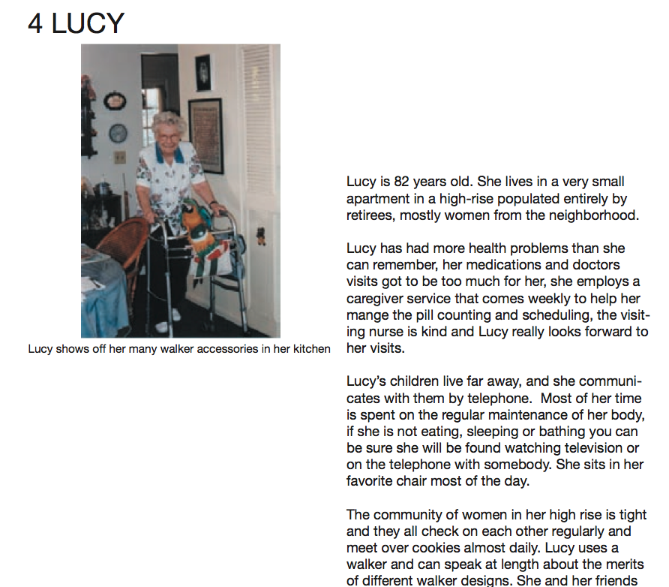

Slide 17
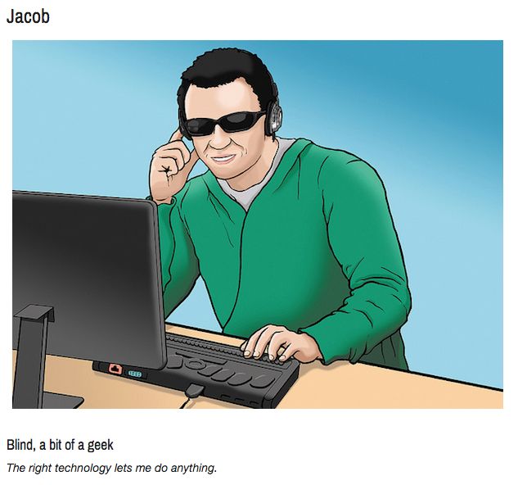
http://uxmag.com/articles/book-excerpt-a-web-for-everyone

Slide 18
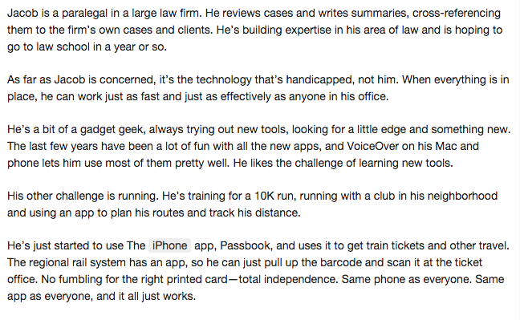

Slide 19
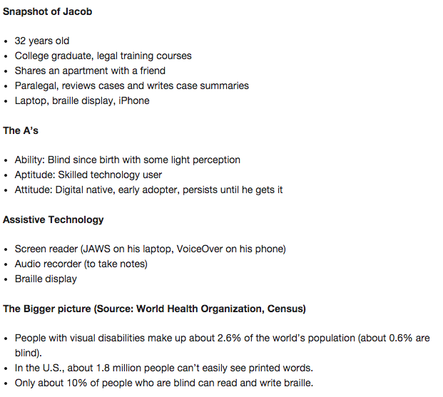

Slide 20
Choosing attributes
What characteristics are important about your user?
What will affect how they interact with the technology?
What differentiates them from each other (and from others)?
Can then combine these (a la bootstrapping)

Slide 21
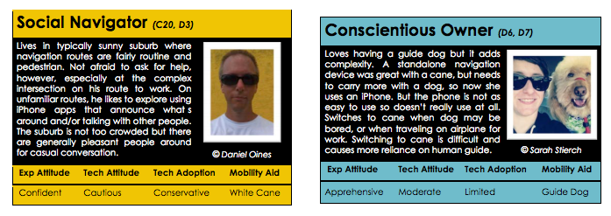
Michele A. Williams, Amy Hurst, and Shaun K. Kane. 2013. "Pray before you step out": describing personal and situational blind navigation behaviors. In Proceedings of the 15th International ACM SIGACCESS Conference on Computers and Accessibility (ASSETS '13). ACM, New York, NY, USA, , Article 28 , 8 pages. DOI=10.1145/2513383.2513449

Slide 22
Let’s try it
Come up with 5 attributes describing your users
Write one interesting persona describing a potential user

Slide 23
What to do with personas?
Hang them up
Bring them to meetings
Discuss them with clients
Write scenarios about them

Slide 24
Further reading
Pruitt, J., & Grudin, J. (2003, June). Personas: practice and theory. In Proceedings of the 2003 conference on Designing for user experiences (pp. 1-15). ACM. http://ued.taobao.org/blog/wp-content/uploads/2006/10/Personas%20practice%20and%20theory.pdf

Slide 25
Users vs. stakeholders (or primary vs. secondary users)
Remember that the primary user is often not the only person who interacts with a computing system
Consider a new electronic door lock system for CU dorms
Who is the primary user?
Who else might interact with the system?

Slide 26
Scenarios
We already generated tasks (through task analysis, brainstorming, competitive analysis)
But:
Tasks not very rich
Do not capture the context of use
Boring

Slide 27
Scenarios
Very short stories describing how a user (represented by a persona) performs a task using technology
Should capture
What their goal is
Their context (environment, activities)
What technology they use
What steps they take
Whether they are successful

Slide 28
Example scenario
I didn’t come up with one! Let’s write one

Slide 29
Further reading
Jeff Sauro, Measuring Usability. Seven Tips for Writing Usability Task Scenarios. http://www.measuringusability.com/blog/task-tips.php

Slide 30
Targeted vs. non-targeted use
Users will not always use technology for intended tasks
Use cell phone camera as flashlight, mirror (to check teeth), periscope
Some use technology for nefarious purposes

Slide 31
What to do about non-targeted use?
May decide to support it
Many flashlight apps
May decide to block it
Either way, useful to understand it

Slide 32
Extending the model
Mark A. Blythe and Peter C. Wright. 2006. Pastiche scenarios: Fiction as a resource for user centred design. Interact. Comput. 18, 5 (September 2006), 1139-1164. http://markblythe.me.uk/MarkBlythe/Journals_files/Pastiche%20Scenarios.pdf
Lisa P. Nathan, Batya Friedman, Predrag Klasnja, Shaun K. Kane, and Jessica K. Miller. 2008. Envisioning systemic effects on persons and society throughout interactive system design. In DIS '08. ACM, New York, NY, USA, 1-10. http://dl.acm.org/citation.cfm?id=1241046

Slide 33
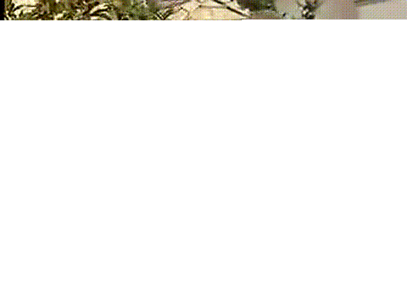
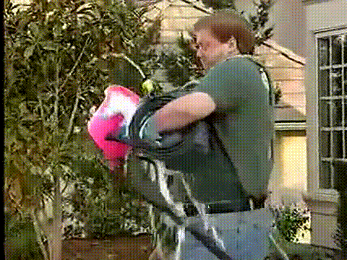
Let’s try it
Write two scenarios for your project work
Before your system
Using your system

Slide 34
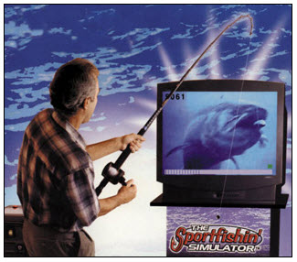
Next time
Input and output devices
Notes:
http://www.portlandpartyworks.com/virtual_fishing.jpg

